Slide 1
Background Check Services Review

Slide 2
Criminal Background Checks (USA)
Criminal Records can be checked on Federal, State, and County levels. The most accurate searches cover all three. Our Criminal searches include, but are not limited to:
County Criminal Records Search
State Criminal Records
Federal Criminal Records
Sex Offender Registry Search
U.S. Social Security Trace/ Consent Based SSN Verification

Slide 3
County Criminal Records Search
Most felony and misdemeanor cases are filed in county courts, so county criminal record searches are one of the most powerful sources for uncovering criminal records. County criminal searches return information from the court records in which the conviction is recorded. A report covering county criminal records may include information regarding the degree of the offense, offense dates, case numbers, filing dates, defendants, counts, trial dates, verdicts, disposition, disposition dates, and sentencing information.
The recommendations are derived from a SSN-based name and address history we run and present in real-time while you are entering the subject’s search criteria on the order screen. Typically, we recommend to our clients that they search the Counties where your subject has lived during the last 7 years.

Slide 4
State Criminal Records (Multi-State)
Multi State Criminal & National Sex Offender Registry
This is an Instant Criminal Database Search. Search results vary based on jurisdiction from Felony convictions to details including records from traffic courts and Sex Offender Registries.

Slide 5
Federal Criminal Records
Federal district courts can be searched for crimes that occurred on federal property and convictions of federal laws. Examples include Tax evasion, mail and wire fraud, drug trafficking, immigration law violations and postal offenses.
Records provide a criminal history from the date of disposition, parole or release from imprisonment.

Slide 6
US Social Security Trace
A Social Security Number Scan reports names and addresses associated with a particular Social Security Number.
A Social Security Number Scan may also be referred to as a SSN Trace or a Person Search. (AKA’s that are identified in an applicant's Social Security Trace can also be searched)
The primary source of information for a Social Security Number Scan is the header information from credit applications submitted to a Credit Reporting Agency. The name, address, Social Security Number, and employer (no credit information) listed for each credit application are placed into a separate database for later searching. The scan finds all names and addresses in the file associated with a specific Social Security Number.
The name and address information obtained from credit header records is only as reliable as the information reported to and entered by the credit agencies. Names can be misspelled, social security numbers can be wrong, and addresses can be entered incorrectly. This is a potential weakness of this program

Slide 7
CBSV- Consent based Social Security Verification
CBSV is commonly used by companies that provide banking and mortgage services, process credit checks, provide background checks, satisfy licensing requirements, etc.
With the consent of the SSN holder, CBSV can verify if the SSN holder’s name, date of birth, and SSN match SSA’s records. CBSV returns a match verification of “yes” or “no.” If our records show that the SSN holder is deceased, CBSV returns a death indicator. CBSV does not verify an individual’s identity.

Slide 8
Drug + Health Screening Services (DOT + Non-DOT)
Pre-Employment Testing (DOT+ NON-DOT)
Instant/POCT Testing
Mobile-/On Site Testing
Post Accident Testing
Random Testing
Reasonable Cause Testing
Return to Duty Testing
Tests
Urine
Saliva
Breath/ Alcohol
Hair
Blood

Slide 9
Medical Review Officer Services
Medical Review Officer (MRO) Services are the first line of defense in drug testing. US Information Search provides access to a far-reaching and highly qualified team of medical doctors certified by the American Association of Medical Review Officers (AAMRO) and the Medical Review Officer Certification Council (MROCC), with extensive experience in the review of DOT & Non-DOT drug tests.
Services include:
Electronic data management
Final disposition of records
Chain of Custody management tools
Real-time status updates
Qualified third party Translator Service for interviews with non-English speaking donors
MRO Expert testimony and telephone litigation support
MRO consultation regarding testing program implementation, interpretation, prescription abuse and prescription monitoring

Slide 10
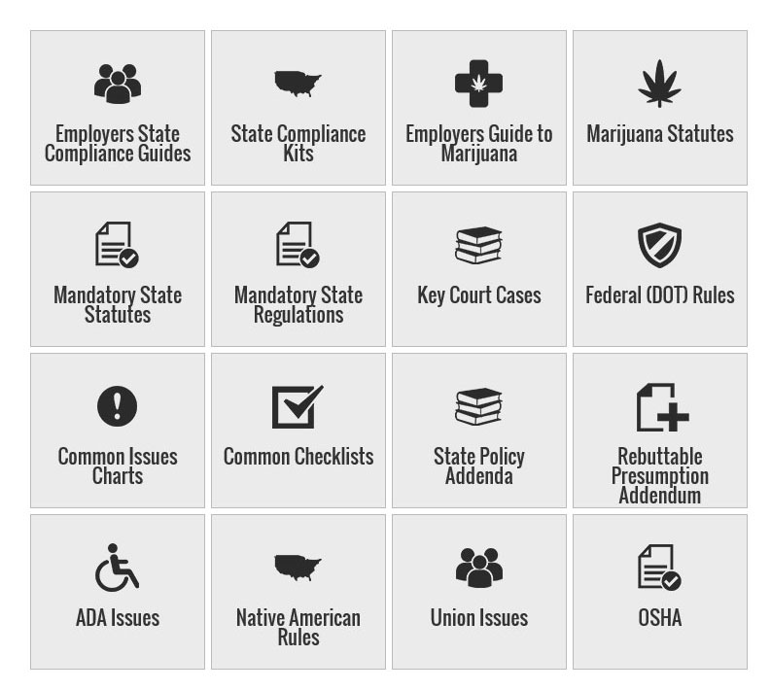
Drug Testing Compliance:
Compliance and regulatory issues are an obvious concern for companies performing drug and alcohol testing. Marijuana laws, mandatory state laws, ADA and OSHA issues, workers compensation rules and required unemployment procedures impact every employer.
US Information Search partakes in one of the world’s most complete resource on all aspects of drug & alcohol testing.

Slide 11
Verifications
Current/ Past Employer Verification
Education Verifications
Professional License Check
Professional Reference Check
Extended Workforce Screening

Slide 12
Current/ Past Employer Verification
Past Employment Verification is recommended for all employees.
It is approximated that 40% of all resumes and employment applications contain falsified information.
The in-house Reference and Verification Department at U.S. Information Search offers verification of the employer’s name, applicant’s title, and dates of employment

Slide 13
Current/ Past Employer Verification- Investigative Report
If the company will answer additional questions, we ask the following questions and ask for a rating of from 1-10:
How was the employee’s attendance?
Are they eligible for re-hire?
Do they work well with others?
How are the employee’s work habits?
How are the employee’s written and verbal communication skills? Was there any disciplinary action taken against the employee?
Overall performance?
Reason for leaving the company?
Any other comments?

Slide 14
Education Verification
Statistics reveal that education is one of the things that applicants falsify most often on employment applications.
U.S. Information Search generally verifies college degrees, unless clients ask that we verify high school also or “highest degree” earned.
U.S. Information Search Education Verification will report the applicant’s dates of attendance, graduation date and degree earned. Some educational institutions will report GPA.

Slide 15
Professional License Checks
By contacting the issuing agency, licensing board or institution, US Information Search will confirm the license type, status, certificate or designation number, date of issuance/expiration, and any disciplinary actions.
Professional License Checks may be included in an employer’s screening package or ordered individually, on an as needed basis. This can include:
Dates of license with issuing institution, board or agency
Meeting any compliance obligations

Slide 16
Professional Reference Checks
Professional references help organizations gain an additional level of information on their applicant, beyond what is listed on their resume, that can provide them greater insight to a person’s work ethic and abilities.
US Information Search’s in house verifications team conducts personal and professional references on your behalf, streamlining this process with the rest of your order. This can be included within a package or on a need basis.

Slide 17
Extended Workforce Screening
If you’re like many modern employers, the very make-up of your workforce is changing. You may be looking to supplement your regular workforce with temporary and contract workers, vendors, consultants, and interns to help keep your organization moving forward.
As the employment landscape changes and evolves, keep your company protected as you hire a Contingent Workforce (Part Time, Contract,…)

Slide 18
Other Searches
------------------------------------------------------- | -------------------------------------------------------
Credit Reports | Workers Compensation Check
Bankruptcy | Prohibited Parties Check
Federal Civil Records Search | County Civil Records Search
Tenant Screening | Volunteer Screening
FACIS | NPDB
OIG | Drivers License Monitoring
OFAC | Continuous Screening

Slide 19
Credit Reports
The credit report run by U.S. Information Search is designed for employment purposes, so they do not count as an inquiry on the individual’s report or reveal either date of birth or a credit score.
The report may include verification of the applicants’ name, their current address and up to two previous addresses, current phone number, current employer, up to three previous employers, and any aliases associated with the Social Security Number. The credit summary portion of the report contains the complete file including public records (i.e., liens, judgments, etc.), collection accounts, current or previous delinquent accounts, types of credit, total indebtedness, and “profile” (i.e., account charged off, repossessed, etc.).

Slide 20
Federal/ County Civil Searches
Federal Civil Records Search (District)
Search of Federal district courts for civil cases involving alleged violations of federal statutes or constitutional rights.
Cases may be brought by individuals, companies or governmental entities seeking monetary damages, an injunction, and/or another
remedy provided by law.
Case information will include the party name, case title, the court in which the case is located, case number, filing date, nature of suit and closing date.
County Civil Records Search
This search provides a quick way to learn if a person or company is involved in any litigation.
The data comes directly from the individual counties and contains filings of court cases containing all plaintiffs, defendants, case numbers, and date of filings. The type of filings available does vary from county to county.

Slide 21
FACIS
Fraud & Abuse Control Information System (FACIS) is a vast database detailing improper actions of individuals and entities sanctioned in the healthcare field.
This includes information on disciplinary actions ranging from exclusions and debarments to letters of reprimand and probation. It is widely used by hospitals, pharmacies, healthcare systems, insurance companies and home health companies in order to meet state and federal hiring regulations.

Slide 22
OIG
An Office of the Inspector General (OIG) Search is widely used investigation tool for hospitals, pharmacies, insurance companies and other companies in the healthcare field.
An OIG investigations background check, identifies individuals who have been sanctioned for identity theft or abusing the government healthcare and welfare systems.

Slide 23
NPDB
Congress created the National Practitioner’s Databank (NPDB) in response to increasing medical malpractice litigation and the need to ensure high quality of care.
You can use the NPDB database to perform comprehensive sanctions background checks and to identify physicians and other healthcare practitioners who have been reported as incompetent or have engaged in unprofessional activities.
As part of a comprehensive background check, this sanctions check is intended to augment, not replace, traditional forms of credentials review.

Slide 24
OFAC/ Prohibited Parties Check/ Terrorist Watch List
Through The Office of Foreign Assets Control (OFAC), the U.S. Treasury Department administers and enforces economic and trade sanctions based on U.S. foreign policy and national security goals.
Of specific interest to OFAC are countries and individuals engaged in terrorism, international narcotics trafficking, those engaged in activities related to the proliferation of weapons of mass destruction, and other threats to the national security, foreign policy or economy of the United States.
By incorporating this sanctions background check into your employment screening, you can identify whether any job candidate is on the government’s OFAC watch list.
This employment investigation is especially helpful to multinational companies or companies hiring foreign staff.

Slide 25
Volunteer/ Tenant Screening
Our volunteer screening services are designed to fit the unique needs of today’s service sector. We understand that not all nonprofits and service organizations are alike—in mission or structure—so a “one size fits all” volunteer background check won’t work.
US Information Search has been supporting volunteer organizations for more than a decade and can provide affordable screening solutions that are easily rolled out to your entire volunteer force, while delivering high quality criminal records searches near instantly through our secure online order dashboards.

Slide 26
Global Services
The capabilities of U.S. Information Search include a full suite of global background checks in more than 200 countries and territories.
Major Markets include:
America
Europe
Asia-pacific
Africa
Middle East
Our background screening tools will provide insight on the skills, experience, and attitudes of your candidates, employees, contractors, or volunteers.
--------------------------------------------------------------
International Background Checks
Education/ Employment Verifications
Credit Reporting Plus Financial History
Due Diligence Testing
Compliance and Risk Databases Searches
Identity Documentation/ Passport Checks

